Slide 1
Interrupts

Slide 2
Interrupts
Interrupts are events that occurred outside the processor and the processor must be informed about them.
Interrupts are asynchronous and unpredictable
The processor responds to interrupt by suspending its current activities, saving its state, and executing a function called an interrupt handler (or an interrupt service routine, ISR) to deal with the event.

Slide 3
Execution of Interrupts
An interrupt handler or ISR may be executed in one of two ways:
An application program containing an INT instruction could cause a call to the routine, which is called a software interrupt
A hardware interrupt occurs when a hardware device (asynchronous port, keyboard, timer, and so on) sends a signal to the Programmable Interrupt Controller chip.
This makes software and hardware two different types of interrupts

Slide 4
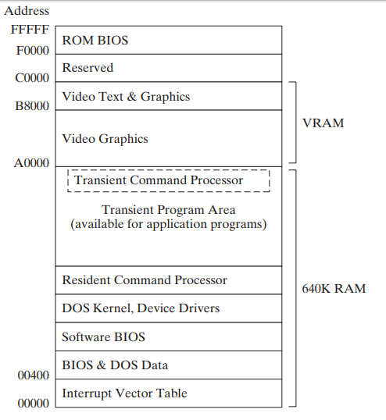
Where is ISR located?
Lets look at memory organization as shown in figure
At physical location 00000 there is interrupt vector table (IVT)
IVT contains the physical address of ISR of each interrupt in form of segment: offset pair
IVT is like a table of content for interrupts.
If you look at IVT in AFD you can see that some ISR are in ROM BIOS some are in DOS Kernel
Next slide gives more details of IVT

Slide 5
Interrupt Vector Table (IVT)
IVT is Located in Memory from 0000:0000 to 0000:1024
Each entry in table is of 4 bytes (i.e 4 bytes per row)
One row per interrupt
First two byte in row are offset of ISR
3rd and 4th byte are segment address of ISR
Segment of nth Interrupt is at n*4th byte in IVT
Offset of nth interrupt is at n*4+2 byte in IVT
The actual addresses in this table vary from one machine to another
Int 0 | offset | segment
Int 1 | offset | segment
Int 2 | offset | segment
Int 3 | offset | segment
…..
Int FF | offset | segment
Interrupt vector table

Slide 6
INT Instruction
Interrupt are invoked using INT instruction
The INT (call to interrupt procedure) instruction calls a ISR
The syntax is
INT <number>
where number is an integer in the range 0 to FF hexadecimal
Parameters are passed to int in register, not on stack. Output is also returned in registers
For example
Mov ax, 0x4C00
Int 21h
Hardware interrupts are invoked implicitly, some software interrupts are invoked implicitly (eg int 0) and some are invoked explicitly (e.g. int 21h). So you will never write int 0 in your code

Slide 7
IRET
Like ret is paired with call to return from subroutine, IRET (interrupt ret) is paired with INT to return from ISR

Slide 8
Interrupt Vectoring
The CPU processes the INT instruction using the interrupt vector table
Steps taken by the CPU when the INT n instruction is invoked by a program:
The operand of the INT instruction is multiplied by 4 to locate the matching interrupt vector table entry.
The CPU pushes the flags and a current CS and IP (return address) on the stack and disables hardware interrupts (by clearing interrupt flag and trap flag )
The CPU Loads segment of interrupt n (n*4 )from IVT to CS and Offset to IP (n*4+2)
The interrupt handler at new segment and offset executes until it reaches an IRET (interrupt return) instruction
The IRET instruction pops the flags and the return address off the stack, causing the processor to resume execution immediately following the INT n instruction in the calling program.

Slide 9
The operation of INT can be written as:
Pushf ; push flag
cli
clt
Push cs
Push ip
ip = [0:N*4]
cs = [0:N*4+2]

Slide 10
The operation of IRET can be written as:
pop ip
Pop cs
Popf ;pop flag

Slide 11
SOFTWARE INTERRUPTS

Slide 12
Software Interrupts
A software interrupt is requested by the processor itself upon executing particular instructions or when certain conditions are met. (they do not exactly fit the definition of interrupts given in slide 2 )
Every software interrupt signal is associated with a particular interrupt handler (or ISR).
Most of these interrupt handlers, provide input–output capability to application programs
They are used for such tasks as the following:
• Displaying characters and strings
• Reading characters and strings from the keyboard
• Displaying text in color
• Opening and closing files
• Reading data from files
• Writing data to files
• Setting and retrieving the system time and date

Slide 13
Common Software Interrupts
INT 0, Division by zero
INT 1, Trap, Single step Interrupt
INT 2, NMI-Non Maskable Interrupt
INT 3, Debug Interrupt
INT 4, Arithmetic Overflow, change of sign bit
INT 10h Video Services
INT 16h Keyboard Services
INT 1Ah Time of Day
INT 17h Printer Services
INT 1Ch User Timer Interrupt
INT 21h MS-DOS Services

Slide 14
Example int 0
You can run the following code and see that int 0 will occur
Mov ax, 10
Mov bl, 0
Div bl ; int 0 will be invoked automatically
Mov ax, 0x4C00
Int 21h
However you will not be able to debug it and if you run it without debugging you will be stuck in infinite loop
This is because int 0 will return to div bl instead of next instruction
Next we will hook and interrupt to better understand it

Slide 15
HOOKING AN INTERRUPT
To hook an interrupt we change the vector corresponding to that interrupt
As soon as the interrupt vector changes, that interrupt will be routed to the new handler
For example
If vector of int 0 is F000h:61AAh
Then on int 0 CS will change to F000h and IP to 61AAh and program will start running from instruction at F000h:61AAh after int 0
If we change the vector of int 0 to 1957h:0110h then on int 0 program will run from 1957h:0110h after int 0
Example 8.1 in BH shows how to hook int 0 such that every time this interrupt occurs “'You divided something by zero.” message is shown on screen. Its show version is given on next slide

Slide 16
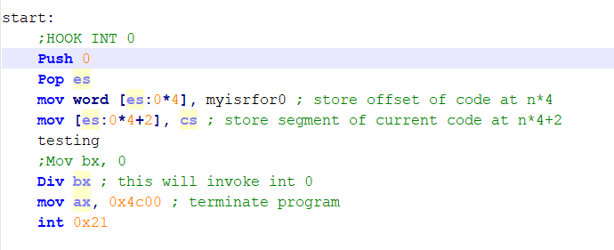
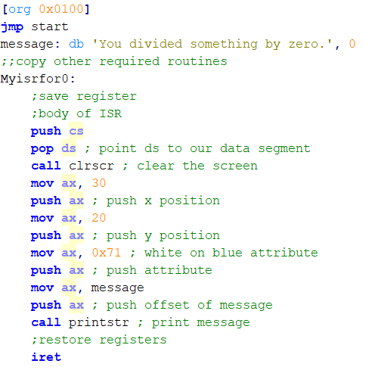
HOOKING AN INTERRUPT Example
Notes:
;interupts
[org 0x0100]
jmp start
message: db 'You divided something by zero.', 0
clrscr:
push es
push ax
push cx
push di
mov ax, 0xb800
mov es, ax ; point es to video base
xor di, di ; point di to top left column
mov ax, 0x0720 ; space char in normal attribute
mov cx, 2000 ; number of screen locations
cld ; auto increment mode
rep stosw ; clear the whole screen
pop di
pop cx
pop ax
pop es
ret
strlen:
push bp
mov bp,sp
push es
push cx
push di
les di, [bp+4] ; point es:di to string
mov cx, 0xffff ; load maximum number in cx
xor al, al ; load a zero in al
repne scasb ; find zero in the string
mov ax, 0xffff ; load maximum number in ax
sub ax, cx ; find change in cx
dec ax ; exclude null from length
pop di
pop cx
pop es
pop bp
ret 4
; subroutine to print
; subroutine to print a string
; takes the x position, y position, attribute, and address of a null
; terminated string as parameters
printstr:
push bp
mov bp, sp
push es
push ax
push cx
push si
push di
push ds ; push segment of string
mov ax, [bp+4]
push ax ; push offset of string
call strlen ; calculate string length
cmp ax, 0 ; is the string empty
jz exit ; no printing if string is empty
mov cx, ax ; save length in cx
mov ax, 0xb800
mov es, ax ; point es to video base
mov al, 80 ; load al with columns per row
mul byte [bp+8] ; multiply with y position
add ax, [bp+10] ; add x position
shl ax, 1 ; turn into byte offset
mov di,ax ; point di to required location
mov si, [bp+4] ; point si to string
mov ah, [bp+6] ; load attribute in ah
cld ; auto increment mode
nextchar: lodsb ; load next char in al
stosw ; print char/attribute pair
loop nextchar ; repeat for the whole string
exit: pop di
pop si
pop cx
pop ax
pop es
pop bp
ret 8
; divide by zero interrupt handler
myisrfor0: push ax ; push all regs
push bx
push cx
push dx
push si
push di
push bp
push ds
push es
push cs
pop ds ; point ds to our data segment
call clrscr ; clear the screen
mov ax, 30
push ax ; push x position
mov ax, 20
push ax ; push y position
mov ax, 0x71 ; white on blue attribute
push ax ; push attribute
mov ax, message
push ax ; push offset of message
call printstr ; print message
pop es
pop ds
pop bp
pop di
pop si
pop dx
pop cx
pop bx
pop ax
iret ; return from interrupt
; subroutine to generate a divide by zero interrupt
genint0: mov ax, 0x8432 ; load a big number in ax
mov bl, 2 ; use a very small divisor
div bl ; interrupt 0 will be generated
ret
start:
xor ax, ax
mov es, ax ; load zero in es
mov word [es:0*4], myisrfor0 ; store offset at n*4
mov [es:0*4+2], cs ; store segment at n*4+2
call genint0 ; generate interrupt 0
mov ax, 0x4c00 ; terminate program
int 0x21

Slide 17
Things to Note in Example
Int 0 pushs flags, CS and IP on stack
IP is of Div bx, not of next instruction
Program will run infinitely as after iret we will return to DIV bx
This is not the case in every interrupt

Slide 18
Template to hook Software interrupt n
newISR:
Store register
Body
Restore register
Iret
Start:
xor ax, ax
mov es, ax ; load zero in es
mov word [es:n*4], newISR; store offset at n*4
mov [es:n*4+2], cs ; store segment at n*4+2

Slide 19
BIOS AND DOS INTERRUPTS
In IBM PC there are certain interrupts designated for user programs to communicate with system software to access various standard services like access to the floppy drive, hard drive, vga, clock etc
Since the manufacturer knows the hardware it burns the software to control its hardware in ROM.
This basic interface to the hardware is called BIOS (basic input output services)

Slide 20
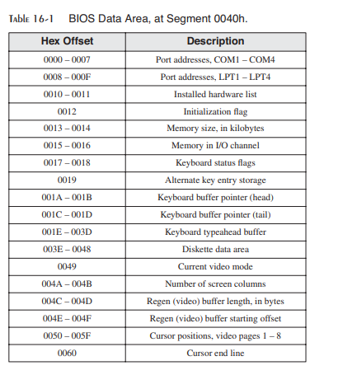
BIOS AND DOS DATA AREA
The BIOS data area, partially shown in Table, contains system data used by the ROM BIOS service routines.
For example, the keyboard typeahead buffer (at offset 001Eh) contains the ASCII codes and keyboard scan codes of keys waiting to be processed by the BIOS.

Slide 21
Video Programming using int 10h
Three Levels of Access
When an application program needs to write characters on the screen in text mode, it can choose among three types of output:
MS-DOS-level access: using int 21h
BIOS-level access: using int 10h
Direct video memory access
Functions/services of int 10h:
Int 10h is software interrupt provided by BIOS to program video memory
Int 10h provides several functions/services
Function code is given in AH
The list of most commonly used is given in table next slide
Also see this link https://en.wikipedia.org/wiki/INT_10H

Slide 22
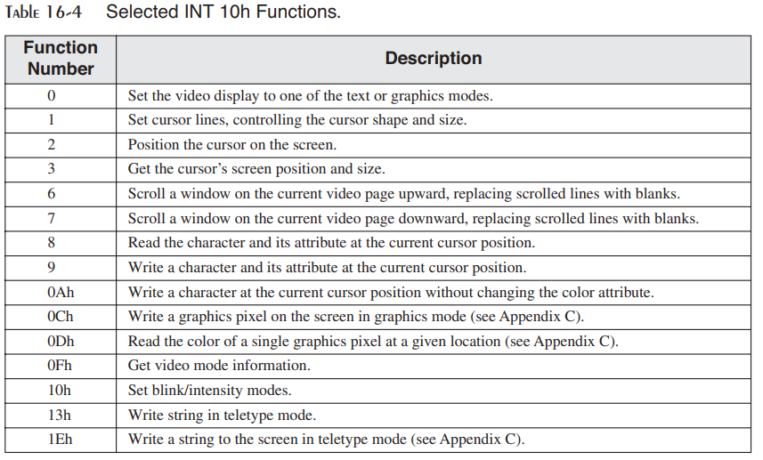

Slide 23
Video Programming using int 10h
Video modes
There are two basic video modes on Intel-based systems, text mode and graphics mode.
A program can run in one mode or the other, but not both at the same time:
In text mode, programs write ASCII characters to the screen.
In graphics mode, programs control the appearance of each screen pixel.
A programmer can set the mode using int 10h service 0

Slide 24
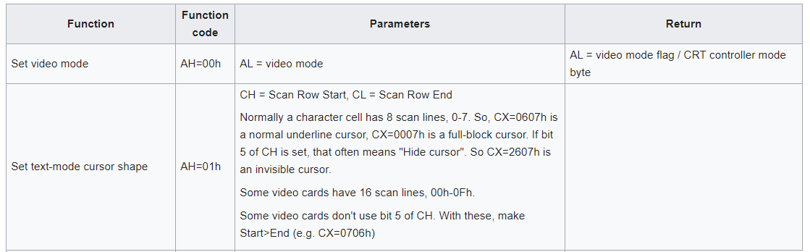
Example int 10h function 01h
Using function 1 of int 10 to change cursor size
mov ah,1 ; function
mov cx,0614h ; parameter, default color cursor size
int 10h
Try different values of CH and CL

Slide 25
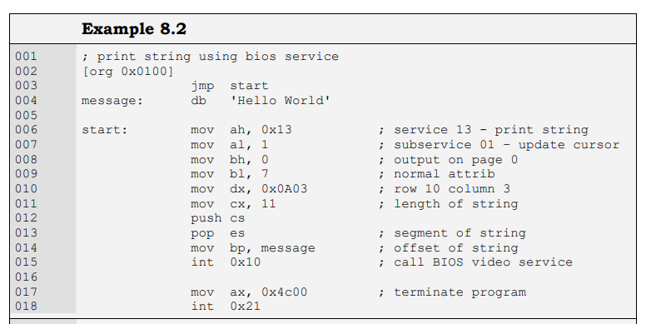
Example int 10h function 13h
Al is the write mode in int 10h service 13.
0th bitrepresent if cursor should be updated or not
1st bit represents if string contains the settings or not.
Notes:
; print string using bios service
[org 0x0100]
jmp start
message: db 'Hello World'
start: mov ah, 0x13 ; service 13 - print string
mov al, 1 ; subservice 01 – update cursor
mov bh, 0 ; output on page 0
mov bl, 7 ; normal attrib
mov dx, 0x0A03 ; row 10 column 3
mov cx, 11 ; length of string
push cs
pop es ; segment of string
mov bp, message ; offset of string
int 0x10 ; call BIOS video service
mov ax, 0x4c00 ; terminate program
int 0x21
Text video screen is in the form of pages which can be upto 32. At one time one page is visible which is by default the zeroth page unless we change it.

Slide 26
Example int 10h function 02h
mov ah,2
mov dh,10 ; row 10
mov dl,20 ; column 20
mov bh,0 ; video page 0
int 10h

Slide 27
Keyboard Input with INT 16h
Int 16h is a software interrupt provided by bios to handle keyboard
Keyboard input follows an event path beginning with the keyboard controller chip and ending with characters being placed in an array called the keyboard typeahead buffer (see Fig. in next slide).
Up to 15 keystrokes can be held in the buffer because a keystroke generates 2 bytes (ASCII code + scan code).
Notes:
A scancode (or scan code) is the data that most computer keyboards send to a computer to report which keys have been pressed. A number, or sequence of numbers, is assigned to each key on the keyboard.

Slide 28
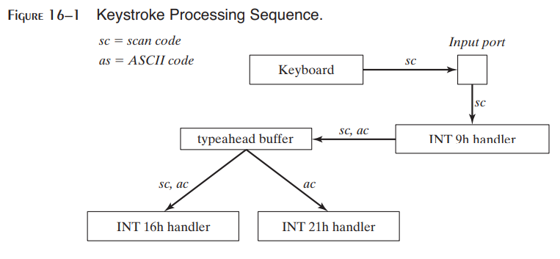

Slide 29
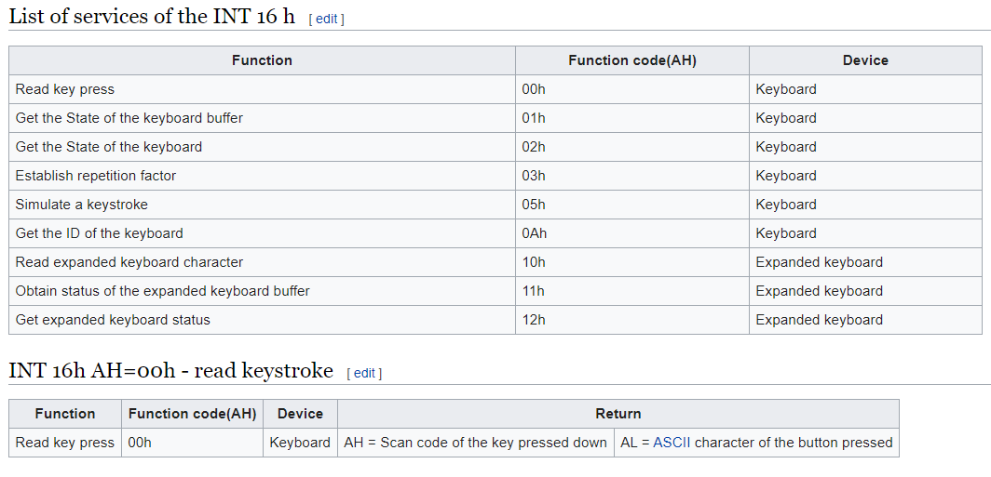

Slide 30
Read keystroke using int 16h function 00h
Mov ah, 0
Int 16h;
Notes:
In given code the keystore is saved in key variable and printed on screen
; get key stroke
[org 0x0100]
jmp start
key: dw 0
start:
mov ah, 00
int 16h
mov word [key],ax
mov ah, 0x13 ; service 13 - print string
mov al, 1 ; subservice 01 – update cursor
mov bh, 0 ; output on page 0
mov bl, 7 ; normal attrib
mov dx, 0x0A03 ; row 10 column 3
mov cx, 2; length of string
push cs
pop es ; segment of string
mov bp, key ; offset of string
int 0x10 ; call BIOS video service
mov ax, 0x4c00 ; terminate program
int 0x21

Slide 31
Print string and keyboard wait using BIOS services
Example 8.3 in book.
Also see code given in comments
Notes:
; print string using bios service
[org 0x0100]
jmp start
msg1: db 'hello world', 0
msg2: db 'hello world again', 0
msg3: db 'hello world again and again', 0
clrscr:
push es
push ax
push cx
push di
mov ax, 0xb800
mov es, ax ; point es to video base
xor di, di ; point di to top left column
mov ax, 0x0720 ; space char in normal attribute
mov cx, 2000 ; number of screen locations
cld ; auto increment mode
rep stosw ; clear the whole screen
pop di
pop cx
pop ax
pop es
ret
start:
mov ah, 0x10 ; service 10 – vga attributes
mov al, 03 ; subservice 3 – toggle blinking
mov bl, 01 ; enable blinking bit ; if bl=00 then even by setting blinking bit on we will not be able to see blinking on screen
int 0x10 ; call BIOS video service
mov ah, 0 ; service 0 – get keystroke
int 0x16 ; call BIOS keyboard service
call clrscr ; clear the screen
mov ah, 0x13 ; service 13 - print string
mov al, 1 ; subservice 01 – update cursor
mov bh, 0 ; output on page 0
mov bl, 01 ; normal attrib
mov dx, 0x0A03 ; row 10 column 3
mov cx, 11 ; length of string
push cs
pop es ; segment of string
mov bp, msg1 ; offset of string
int 0x10 ; call BIOS video service
mov ah, 0 ; service 0 – get keystroke
int 0x16 ; call BIOS keyboard service
mov ah, 0x13 ; service 13 - print string
mov al, 1 ; subservice 01 – update cursor
mov bh, 0 ; output on page 0
mov bl, 0x71 ; normal attrib
mov dx, 0x0B03 ; row 10 column 3
mov cx, 17 ; length of string
push cs
pop es ; segment of string
mov bp, msg2 ; offset of string
int 0x10 ; call BIOS video service
mov ah, 0 ; service 0 – get keystroke
int 0x16 ; call BIOS keyboard service
mov ah, 0x13 ; service 13 - print string
mov al, 1 ; subservice 01 – update cursor
mov bh, 0 ; output on page 0
mov bl, 0xF4 ; normal attrib
mov dx, 0x0C03 ; row 10 column 3
mov cx, 27 ; length of string
push cs
pop es ; segment of string
mov bp, msg3 ; offset of string
int 0x10 ; call BIOS video service
mov ax, 0x4c00 ; terminate program
int 0x21

Slide 32
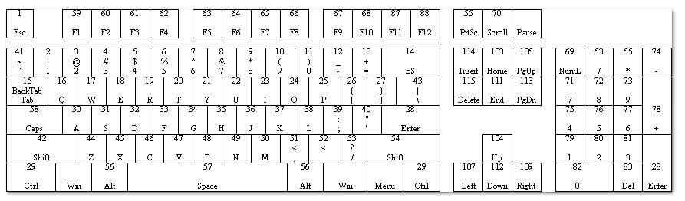
Scan codes of keys

Slide 33
Hardware Interrupts

Slide 34
Hardware Interrupts
A hardware interrupt request (IRQ) is an electronic signal issued by an external (to the processor) hardware device, to communicate that it needs attention from the operating system (OS) or, if there is no OS, from the "bare-metal" program running on the CPU.
Such external devices may be part of the computer (e.g., disk controller) or they may be external peripherals. For example, pressing a keyboard key or moving the mouse triggers hardware interrupts that cause the processor to read the keystroke or mouse position
Occasionally, programs must disable hardware interrupts when performing sensitive operations on segment registers and the stack. The CLI (clear interrupt flag) instruction disables interrupts, and the STI (set interrupt flag) instruction enables interrupts

Slide 35
Hardware Interrupts
A Single pin outside the processor called the INT pin is used by external hardware to generate interrupts.
There are many devices generating interrupts and there is only one pin going inside the processor and one pin cannot be technically derived by more than one source
Therefore a controller called the Programmable Interrupt Controller (8259 PIC) is used to schedule the interrupts (priority Schedule)

Slide 36
PIC-Programmable Interrupt Controller
It has eight input signals and one output signal.
It assigns priorities to its eight input pins from 0 to 7 so that if more than one interrupt comes at the same times
0 has the highest priority and 7 has the lowest
A lower-level interrupt cannot interrupt a higher-level one still in progress.
The highest priority one is forwarded and the rest are held till that is serviced.
The rest are forwarded one by one according to priority after the highest priority one is completed
The original IBM XT computer had one PIC so there were 8 possible interrupt sources. However IBM AT and later computers have two PIC totaling 16 possible interrupt sources.

Slide 37
IRQ
The eight input signals to the PIC are called Interrupt Requests (IRQ).
The eight lines are called IRQ 0 to IRQ 7
Each IRQ is mapped to a specific interrupt in the system, as shown in table
IRQ | Interrupt | Description
0 | 8h | System timer (18.2 times/second)
1 | 9h | Keyboard
2 | 0Ah | Programmable Interrupt Controller
3 | 0Bh | COM2 (serial port 2)
4 | 0Ch | COM1 (serial port 1)
5 | 0Dh | LPT2 (parallel port 2) used for sound card or the network card or the modem
6 | 0Eh | floppy disk drive
7 | 0Fh | LPT1 (parallel port 1)

Slide 38
IRQ
This mapping is done by the PIC and not the processor.
The actual mechanism fetches one instruction from the PIC whenever the INT pin is signaled instead of the memory.
We can program the PIC to generate a different set of interrupts on the same interrupt requests.
From the perspective of an assembly language programmer an IRQ 0 is translated into an INT 8 without any such instruction in the program and that’s all

Slide 39
IRQ
Therefore an IRQ 0, the highest priority interrupt, is generated by the timer chip at a precise frequency and the handler at INT 8 is invoked which updates the system time.
A key press generates IRQ 1 and the INT 9 handler is invoked which stores this key.
To hook the timer and keyboard interrupts one can replace the vectors corresponding to interrupt 8 and 9 respectively.

Slide 40
IRQ
When processor received a hardware interrupt number from PIC at its int port, it will do the same thing to handle it as any other interrupt.
That is , push old values of flags, CS and IP, read IVT table to to to ISR of interrupt and execute it.
At the end of servicing the interrupt the handler should inform the PIC that it is completed so that lower priority interrupts can be sent from the PIC.
This signal is called an End Of Interrupt (EOI) signal and is sent through the I/O ports of the PIC.
I/O ports will be discussed soon

Slide 41
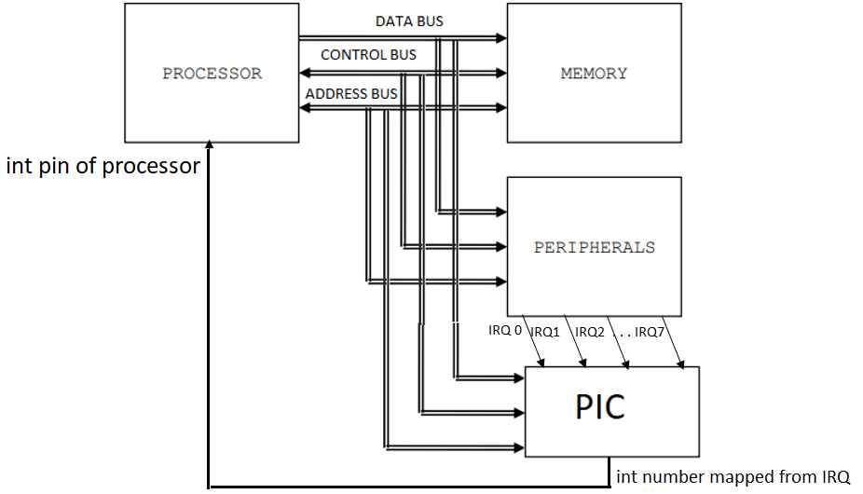
Processor is not always paying attention to peripherals, if it was how will it run other processes?
To get processors attention peripherals send IRQ to PIC
PIC then sends INT to processor
Processor can then ran the ISR and data us usually read/write on devices in the ISR
Data is read/written using BUS
EOI is informed to PIC also via BUS

Slide 42
I/O PORTS
PIC is used to get the attention of processor in request of a device
But data is transfer to/from device using BUS
Each device has 8 or 16 bit port number.
To communicate to a device, port number is placed on address bus
A pin is set on control bus to show that the communication is to be between I/O device and CPU (not CPU and memory)
Lower 16 bits of the address bus as used to specify port number, this means that there can be total of 65536 possible I/O ports
For example 20 and 21 port numbers are for PIC, 60 to 64 for Keyboard, 378 for the parallel port etc.

Slide 43
IN and OUT instructions
Used to read and write data to ports. (just like mov is used to read write to mem)
Version 1, when 8bit port number
In al, <8bitport number>; read a byte from port number in al
In ax, <8bitport number>; read a word from port number in al
Out <8bit port number>, al, write a byte in al to port number
Out <8bit port number>, ax, write a word in ax to port number
Version 2, when 16bit port number (port number has to be place in dx)
Mov dx, <16 bit port number>
In al, dx read a byte from port number in al
In ax, dx; read a word from port number in al
Out dx, al, write a byte in al to port number
Out dx, ax, write a word in ax to port number
Notes:
The first 256 ports are directly addressable (address in the instruction) by some inputj output instructions, other instructions let you address the total64K ports indirectly (address in a register).

Slide 44
Example
To read data from keyboard
in al, 0x60, this will read scan code in al
In ax, 0x60; this will read asci in ah and scan code in al
Other example
mov dx, 0x389; DX can contain a port number
in ax,dx ; input word from port named in DX
out dx,ax ; output word to the same port
in ax,0xFFFF; will give error

Slide 45
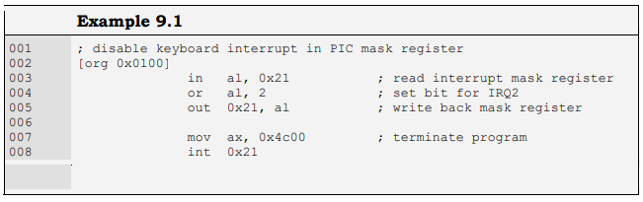
PIC Ports
Programmable interrupt controller has two ports 20 and 21.
Port 20 is the control port while port 21 is the interrupt mask register which can be used for selectively enabling or disabling interrupts.
A 0 bit will enable an interrupt and a 1 bit disables it
Program to disable the keyboard using this port. Is given below
After running this program your keyboard will be disabled. Run the DOSBOX again to restore it to default setting

Slide 46
How Keyboard Works
We have seen earlier int 16h, a software interrupt that is generated by processor to wait for the keyboard stroke
Int 9h is a hardware interrupt that is generated when a key is pressed.
Figure in slide 28 showed then when int 9h is invoked scan code and asci of pressed key are moved to buffer.
For each key the scan code comes twice, once for the key press and once for the key release. Both are scan codes and differ in one bit only.
The lower seven bits contain the key number while the most significant bit is clear in the press code and set in the release code.
You can read the asci and scan code of pressed key using keyboard port
in al, 0x60, this will read scan code in al
In ax, 0x60; this will read asci in ah and scan code in al

Slide 47
How Keyboard Works
If we press Shift-A resulting in a capital A on the screen, the controller has sent the press code of Shift, the press code of A, the release code of A, the release code of Shift and the interrupt handler has understood that this sequence should result in the ASCII code of ‘A’.
The ‘A’ key always produces the same scan code whether or not shift is pressed. It is the interrupt handler’s job to remember that the press code of Shift has come and release code has not yet come and therefore to change the meaning of the following key presses. Even the caps lock key works the same way.
You can hook int 9h and change what happens when a key is pressed

Slide 48
Hooking an interrupt to show scancode at every int9
Run the code given in notes below
See that at press and release of every key int 9 is invoked
Int 9 is hooked in example it will display the scan code on screen
Note that scan code changes on press and unpress
Notes:
;See which scan codes are take as input from key board
[org 0x0100]
jmp start
clrscr:
push es
push ax
push cx
push di
mov ax, 0xb800
mov es, ax ; point es to video base
xor di, di ; point di to top left column
mov ax, 0x0720 ; space char in normal attribute
mov cx, 2000 ; number of screen locations
cld ; auto increment mode
rep stosw ; clear the whole screen
pop di
pop cx
pop ax
pop es
ret
printnum: push bp
mov bp, sp
push es
push ax
push bx
push cx
push dx
push di
mov ax, 0xb800
mov es, ax ; point es to video base
mov ax, [bp+4] ; load number in ax
mov bx, 10 ; use base 10 for division
mov cx, 0 ; initialize count of digits
nextdigit: mov dx, 0 ; zero upper half of dividend
div bx ; divide by 10
add dl, 0x30 ; convert digit into ascii value
push dx ; save ascii value on stack
inc cx ; increment count of values
cmp ax, 0 ; is the quotient zero
jnz nextdigit ; if no divide it again
mov di, 0 ; point di to top left column
nextpos: pop dx ; remove a digit from the stack
mov dh, 0x07 ; use normal attribute
mov [es:di], dx ; print char on screen
add di, 2 ; move to next screen location
loop nextpos ; repeat for all digits on stack
pop di
pop dx
pop cx
pop bx
pop ax
pop es
pop bp
ret 2
; keyboard interrupt service routine
kbisr:
push ax
push es
in al, 0x60 ; read a char from keyboard port
mov ah, 00h
call clrscr
push ax ; place number on stack
call printnum
;mov word [es:0], ax ; yes, print L at top left
mov al, 0x20
out 0x20, al ; send EOI to PIC
pop es
pop ax
iret
start:
xor ax, ax
mov es, ax ; point es to IVT base
cli ; disable interrupts
mov word [es:9*4], kbisr ; store offset at n*4
mov [es:9*4+2], cs ; store segment at n*4+2
sti ; enable interrupts
l1: jmp l1 ; infinite loop

Slide 49
Examples: Hooking int 9
Example 9.2 from book
Example 9.3 from book
Example 9.4 from book
Example 9.5 from book

Slide 50
Question
What is the difference between int 9h and int 16h?

Slide 51
Template to hook Hardware interrupt n
newISR:
Store register
Body
mov al, 0x20
out 0x20, al ; send EOI to PIC
Restore register
Iret
Start:
xor ax, ax
mov es, ax ; load zero in es
mov word [es:n*4], newISR; store offset at n*4
mov [es:n*4+2], cs ; store segment at n*4+2

Slide 52
Controlling speakers through I/O port
See the example given here
http://www.intel-assembler.it/portale/5/make-sound-from-the-speaker-in-assembly/8255-8255-8284-asm-program-example.asp

Slide 53
16.2 16.3 Irvine
Chapter 8 BH
http://jbwyatt.com/253/emu/8086_bios_and_dos_interrupts.html

